Slide 1

NBA Performance Metrics

Slide 2
Project Background
This dataset contains numerous NBA statistics that help determine the duration of an NBA player’s career.
We used visualization techniques to find interesting relationships between different statistics.
We are executing Supervised Learning Algorithms on our dataset to build a predictive model.
KNN - Classification, Decision Trees and Random Forest Classifiers provided us the best accuracy on this dataset.
Our goal is to determine which statistics are most important to the longevity of a player’s career.

Slide 3
Understanding our Dataset
Columns in the data set:
Games Played (GP)- Number of games played by each player during the season
Minutes Played (MIN)- Average minutes played by each player during each game played
Points (PTS)- Average points scored by each player
Field Goals Made (FGM)- Number of shots mode by each player
Field Goals Attempted (FGA)- Total number of shots attempted by each player
Field Goals Percent (FG%)- Percentage of shots made by each player
3 Point field Made (3P Made)- Number of 3 point shots made by each player
3 Point field Attempted (3PA)- Number of 3 point shots made by each player
3 Point field percent (3P%)- Percentage of 3 point shots made by each player

Slide 4
Understanding our Dataset
Columns in the data set:
Free Throws Made (FTM)- Number of free throw attempts made by each player
Free Throws Attempted (FTA)- Number of free throws attempted by each player
Free throws percent (FT%)- Percentage of free throws made by each player
Offensive Rebounds (OREB)- Offensive rebounds by each player
Defensive Rebounds (DREB)- Defensive rebounds by each player
Assists (AST)- Assists by each player
Steals (STL)- Steals by each player
Blocks (BLK)- Blocks by each player
Turnover (TOV)- Turnovers by each player
Number of years of career (Target_5yrs)- Target column, class 0 if player didn’t last 5 years in the league, class 1 if player lasted 5 years or longer in the league

Slide 5
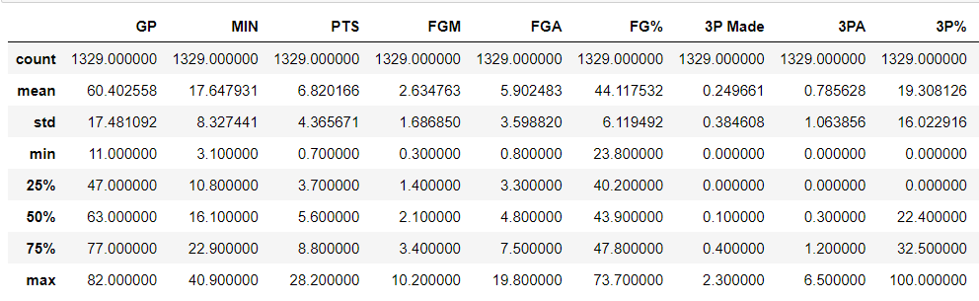
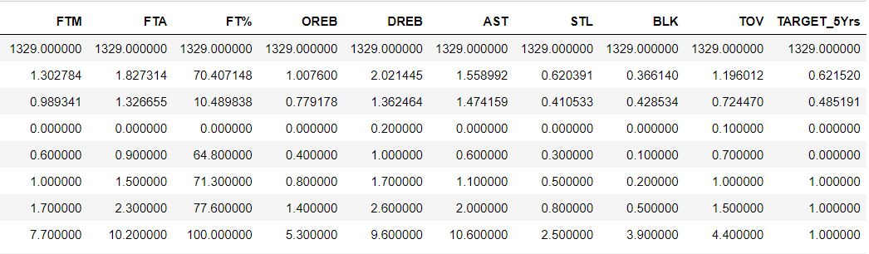
Understanding our Data: Descriptive Statistics

Slide 6
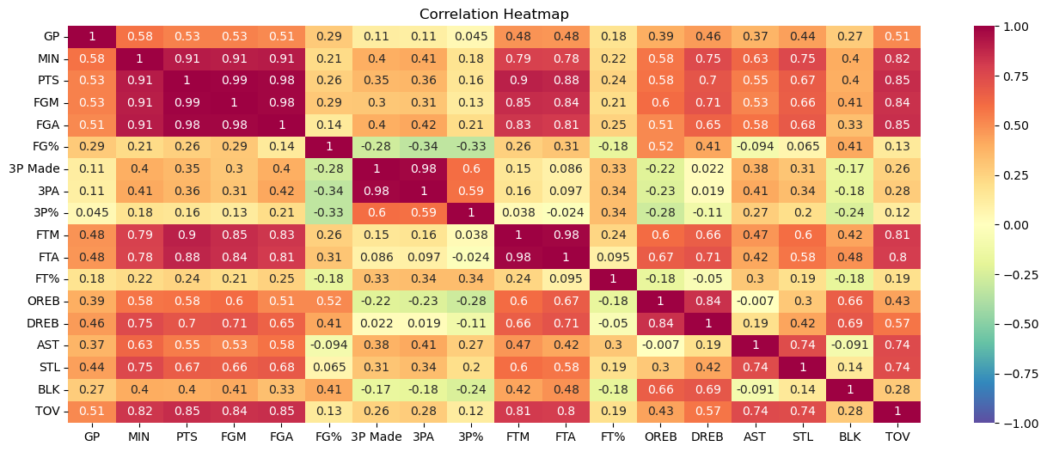
Visualization Plots - Correlation Heatmap

Slide 7
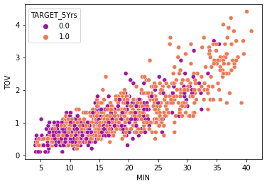
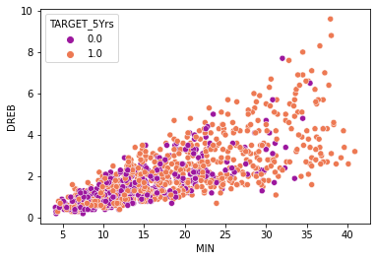
Visualization Plots - Scatterplots

Slide 8
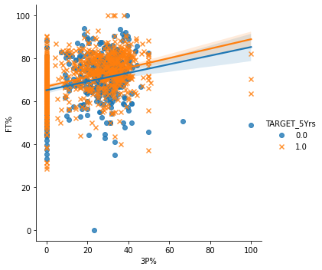
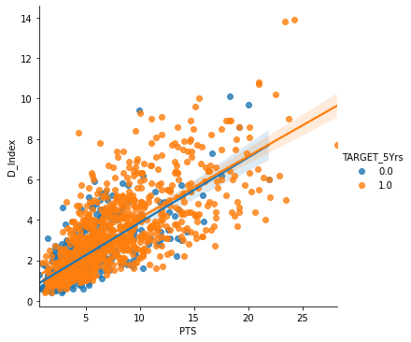
Visualization Plots - Implot

Slide 9
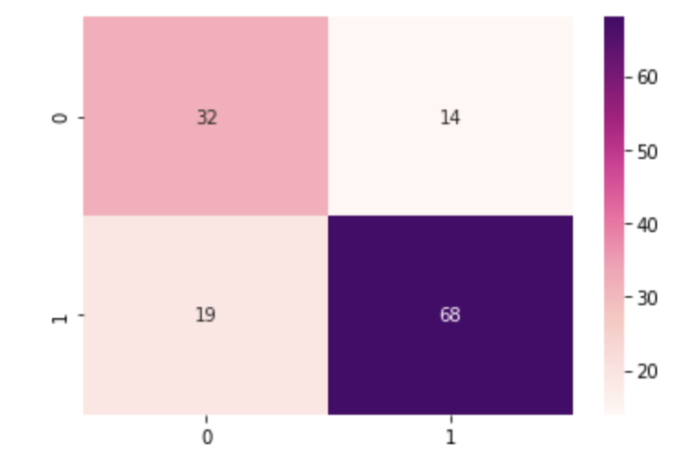
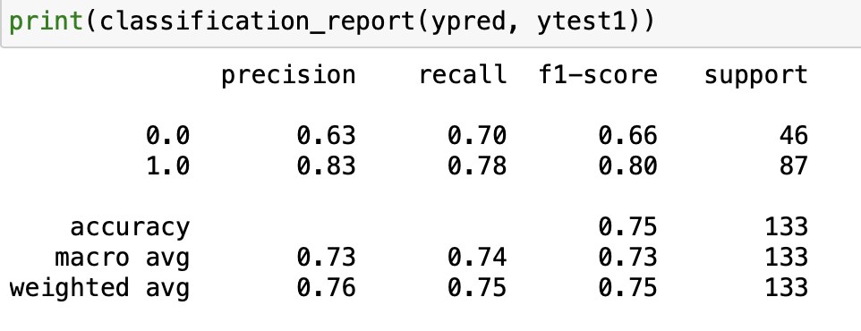
KNN: Classification

Slide 10
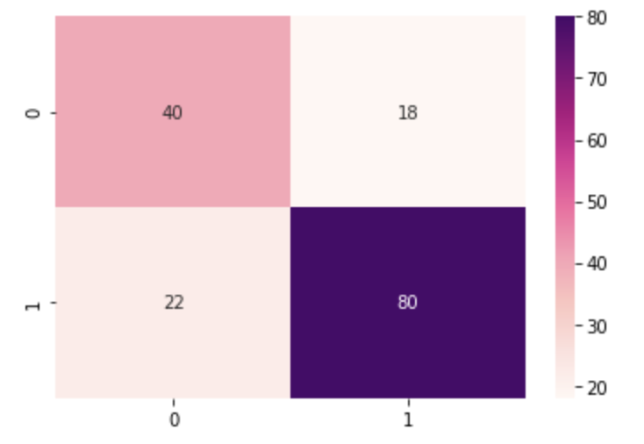
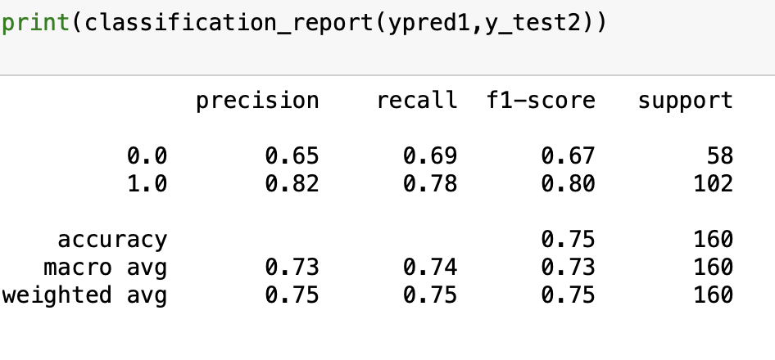
Decision Trees

Slide 11
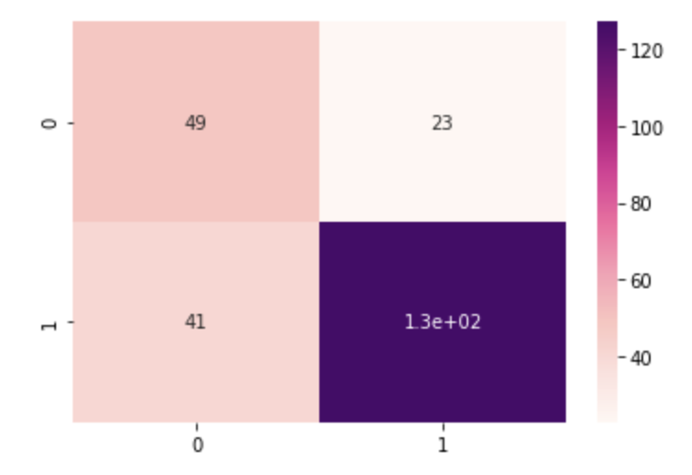
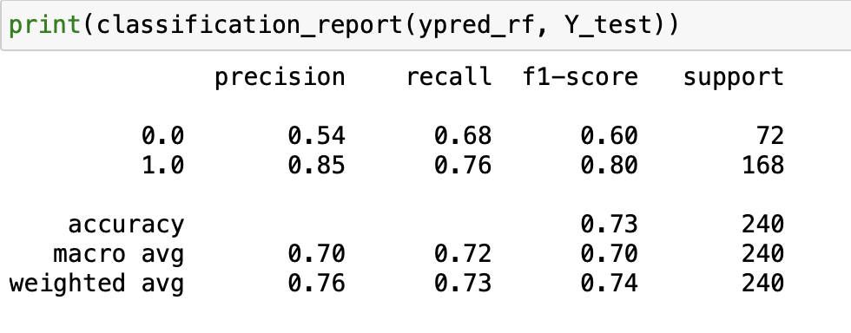
Random Forest

Slide 12


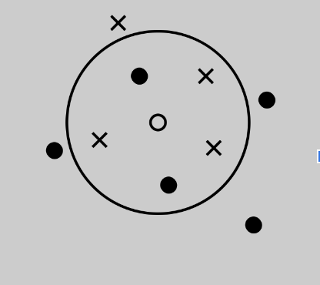
Model Accuracy
Winner 🥳
Sorry :(
Accuracy = 0.72
Accuracy = 0.75
Accuracy = 0.75

Slide 13
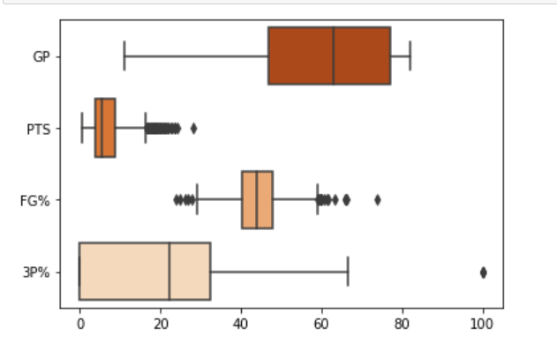
Visualization Plots- Boxplot

Slide 14
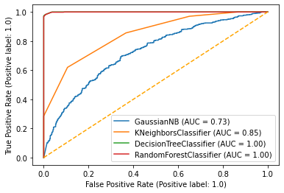
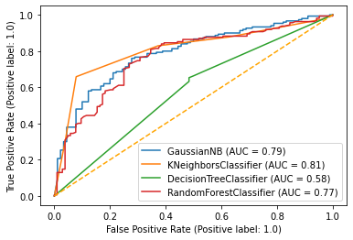
ROC Curve
Training data
Test data

Slide 15
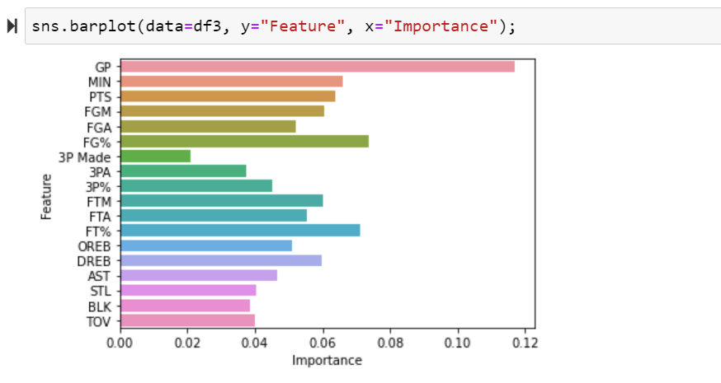
Feature Importance

Slide 16
Conclusions
Games played, field goal percentage and free throw percentage have the biggest impact on the length of a players career
Some of these statistics contain outliers in the dataset, you can’t train these players perfectly so human error is inevitable
Addition of more real world data will assist in training the models better

Slide 17
Business Application
NBA draft decisions
Contracts are based on predicted values of these players
Agents
Sponsorships
Importance of analytics

